Slide 1


Beverly Unegbu Edgar Pineda Foluke Arogundade Wahaj Siddiqui Frank Anderson
Group 5

Slide 2
Raffle Project
ITIL
Continuous Improvement
Java 16.0.1
Validation
SQL (SQLite V3.35)
Primary Key
Random Numbers Generator
Read and write to external Files
Database Management
JUNIT5 (Regression Test)

Slide 3



Raffle Project
The designed project utilizes the Java platform with multiple classes functions, methods etc. which can be implemented in a company's continuous improvement methods (ITIL-4) also it stores collected data in a SQL(SQLite) Database which could in-turn be manipulated to extract specific data.
The Team decided on a raffle situation to collect names, information and distribute rewards for the collection of information on the customer.
Project Scope:
Help with a company’s continual improvement process?
Must have a file for pseudo code
More than 1 class
Multiple functions &/or Methods
Must Request User Input
Must use 1 arithmetic operator
Must use a increment or decrement operator
Must use 1 relational operator
Must use 1 conditional operator
Must use the String class
Must use the Math Class
Must use the Random class
Must have 1 decision making statement
Must use one array
Must have 1 loop
Must show debugging and error handling within program

Slide 4
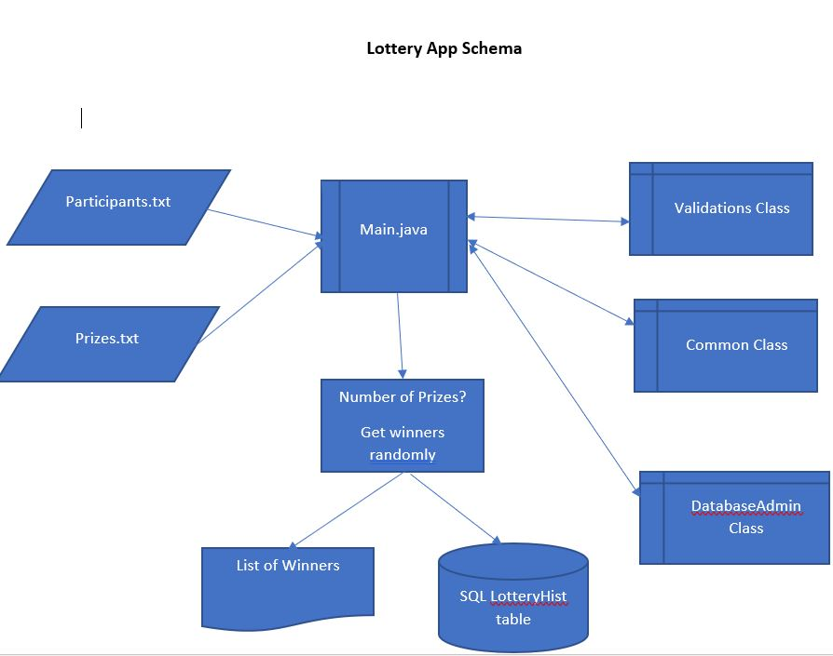
Java (16.0.1)
The Java code has 5 classes and one package together.
The text files contain the Participates names and the Prize files which have the list of what prizes are to be given away.
Main class asked administrator for number of prizes to be awarded and verifies database existence. This class also prints out the winners.
Validation class is utilized to verify if, True or False Boolean; that the number of prizes which are to given away are less than or equal to the amount elected to be given away
Common class pulls in files to java then reads the txt files (both participant list and prize name types. The program then generates a random number using get Random method and assigns a winning number to a participant.
DatabaseAdmin class takes winning names, awarded prize and date of contest and store and retrieving them in a SQLite database.
GetHistoryJava class confirms database exist and prints out if error occurred.
Package class a mechanism for encapsulation of the 4 classes preventing naming conflict

Slide 5
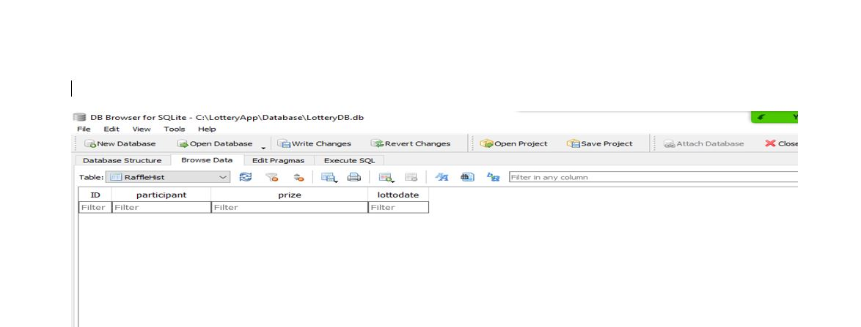
SQL(SQLite)
Before the Java program runs the Database is empty.

Slide 6
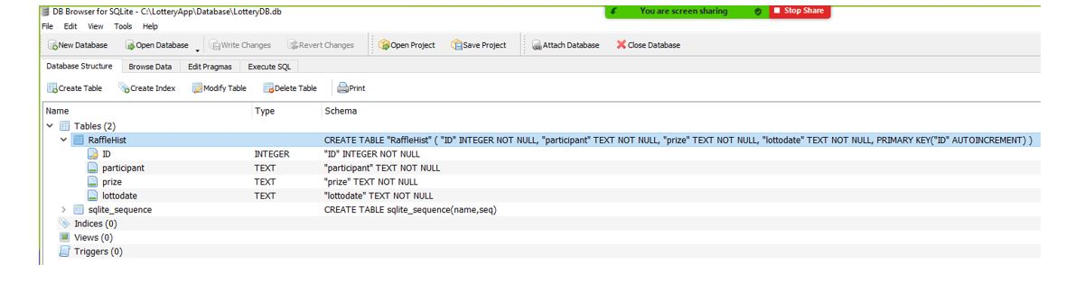
SQL(SQLite)
This is the table Layout.

Slide 7
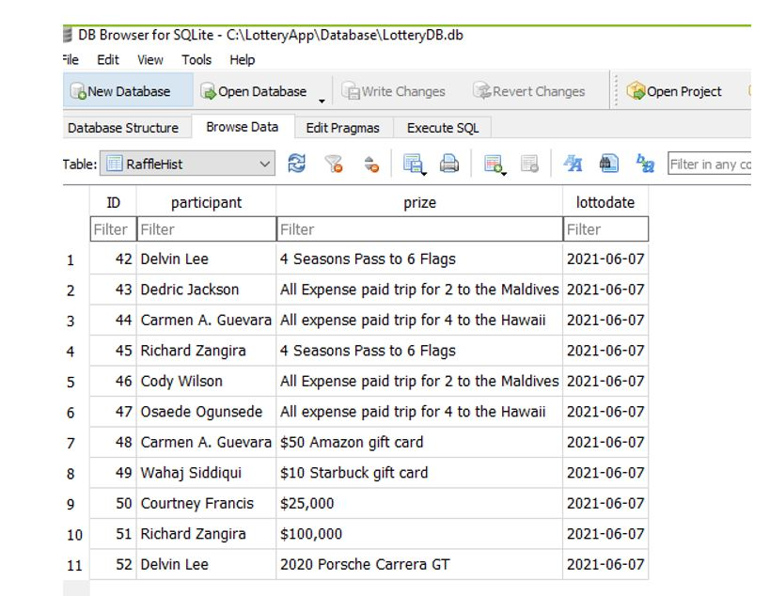
SQL(SQLite)
Below is a sample data set which java pushed to SQL(SQLite).

Slide 8
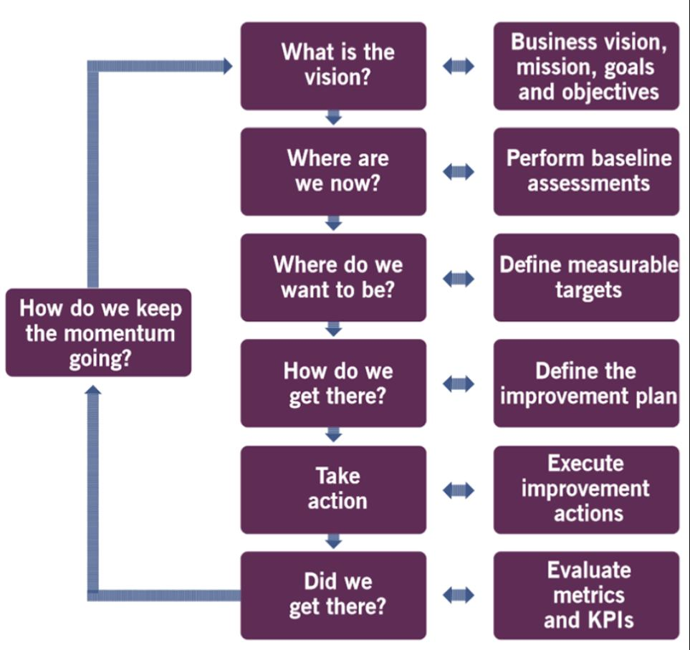
ITIL -4 Continuous Improvement
Customer names and their comments are collected in a Database. The Java program will Import the names from the SQL(SQLite) Database and Randomly select a winner. This winner will receive the predetermined prize.
Continuous Improvement model has seven steps. Applying the Continual Improvement Model can optimize services and maximize success.
(Where are we now) and possible (how do we get there) could be answered using the lottery as an incentive for collecting customer feedback on products and or services offered.

Slide 9

Any Questions?

